Slide 2
DO NOW
Describe the properties of the two items on the front desk.

Slide 3
I know what rocks and minerals are
I know the properties of minerals

Slide 4
Mineral
A naturally occurring solid substance with a definite chemical composition.
Notes:
Inorganic = not from living

Slide 5
Property
Property = characteristic
Characteristic = property

Slide 6
I know what rocks and minerals are
I know the properties of minerals
Making the connection
Properties allow us to identify substances, and also to decide which substance is best suited to a particular task.
Rocks are solid and are found on the surface of the Earth.
Property – Characteristic

Slide 7
I know what rocks and minerals are
I know the properties of minerals
What are the two types of properties?
Minerals are naturally occurring solid substances with definite chemical compositions.
Most rocks are made of minerals
All rocks are found in the lithosphere, which is the outside layer of the Earth.

Slide 8
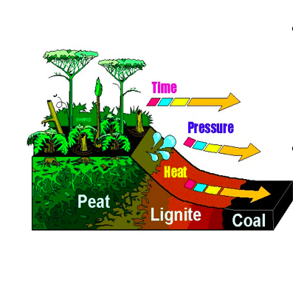
I know what rocks and minerals are
I know the properties of minerals
What are the two types of properties?
Minerals must be:
Naturally occurring made from non-living things
(fossils and coal are made from living things that died so are not considered minerals)
Not man-made

Slide 9
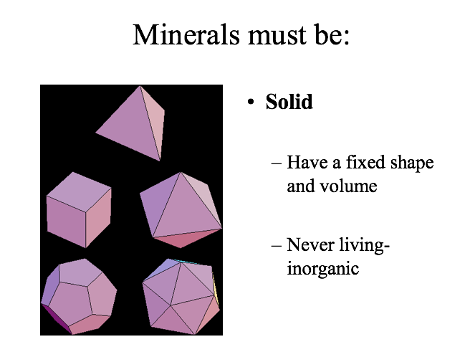
I know what rocks and minerals are
I know the properties of minerals
Magnetism
Rock
Texture
Grain
Minerals
Colour
Hardness
Density
Lustre
Streak
Cleavage
Why are we learning to identify minerals?
Identification means we can decide which substance is best suited to a particular task

Slide 10
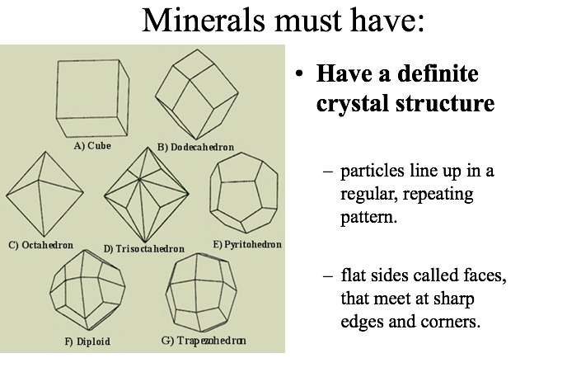
I know what rocks and minerals are
I know the properties of minerals
Magnetism
Rock
Texture
Grain
Minerals
Colour
Hardness
Density
Lustre
Streak
Cleavage
Why are we learning to identify minerals?
Identification means we can decide which substance is best suited to a particular task

Slide 11
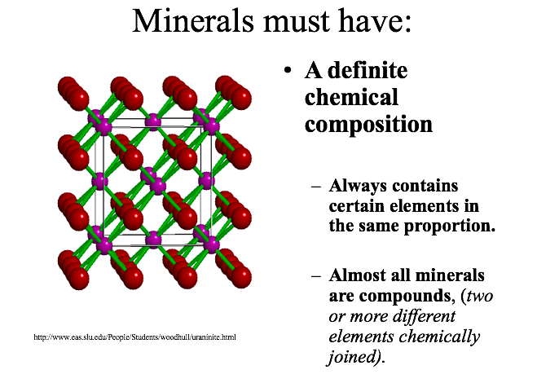
Magnetism
Rock
Texture
Grain
Minerals
Colour
Hardness
Density
Lustre
Streak
Cleavage
Why are we learning to identify minerals?
Identification means we can decide which substance is best suited to a particular task

Slide 12
Magnetism
Rock
Texture
Grain
Minerals
Colour
Hardness
Density
Lustre
Streak
Cleavage
Minerals Review
All minerals must:
Occur naturally in nature
Inorganic solid
Crystal structure
Definite chemical composition
Why are we learning to identify minerals?
Identification means we can decide which substance is best suited to a particular task

Slide 13
Magnetism
Rock
Texture
Grain
Minerals
Colour
Hardness
Density
Lustre
Streak
Cleavage
Lesson Break
Layers of the Earth activity
Why are we learning to identify minerals?
Identification means we can decide which substance is best suited to a particular task

Slide 14
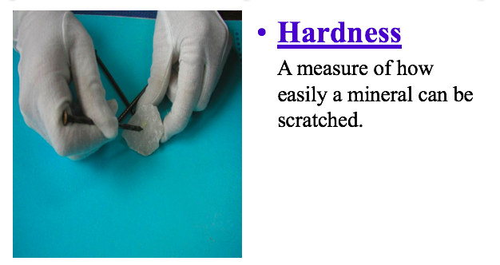
Magnetism
Rock
Texture
Grain
Minerals
Colour
Hardness
Density
Lustre
Streak
Cleavage
Properties of Minerals
Why are we learning to identify minerals?
Identification means we can decide which substance is best suited to a particular task

Slide 15
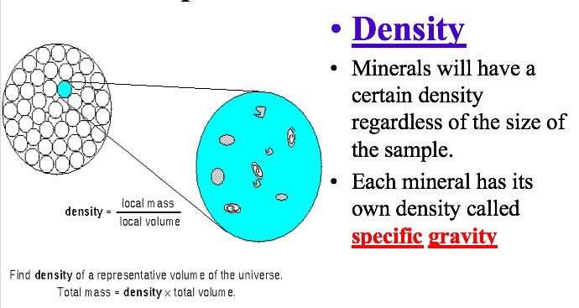
Magnetism
Rock
Texture
Grain
Minerals
Colour
Hardness
Density
Lustre
Streak
Cleavage
Properties of Minerals
Why are we learning to identify minerals?
Identification means we can decide which substance is best suited to a particular task

Slide 16
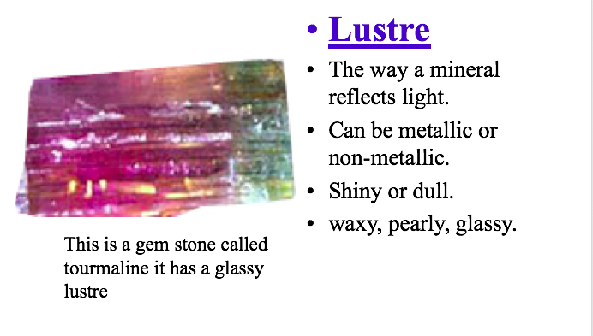
Magnetism
Rock
Texture
Grain
Minerals
Colour
Hardness
Density
Lustre
Streak
Cleavage
Properties of Minerals
Why are we learning to identify minerals?
Identification means we can decide which substance is best suited to a particular task

Slide 17
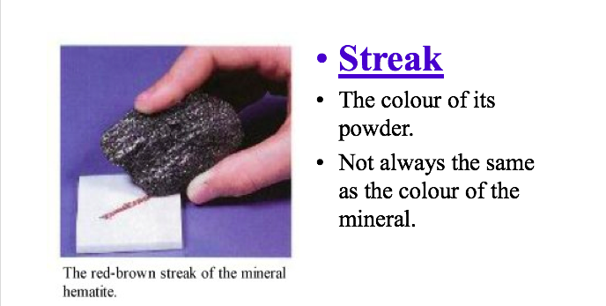
Magnetism
Rock
Texture
Grain
Minerals
Colour
Hardness
Density
Lustre
Streak
Cleavage
Properties of Minerals
Why are we learning to identify minerals?
Identification means we can decide which substance is best suited to a particular task

Slide 18
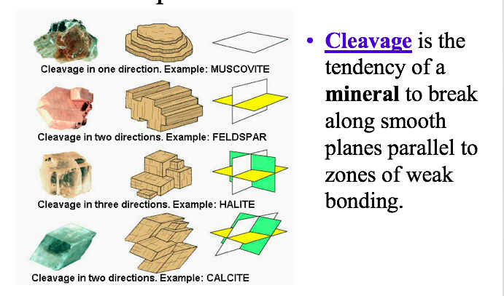
Magnetism
Rock
Texture
Grain
Minerals
Colour
Hardness
Density
Lustre
Streak
Cleavage
Properties of Minerals
Why are we learning to identify minerals?
Identification means we can decide which substance is best suited to a particular task

Slide 19
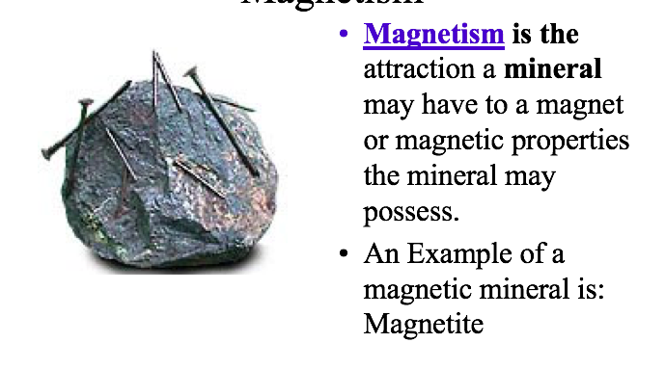
Magnetism
Rock
Texture
Grain
Minerals
Colour
Hardness
Density
Lustre
Streak
Cleavage
Properties of Minerals
Why are we learning to identify minerals?
Identification means we can decide which substance is best suited to a particular task

Slide 20
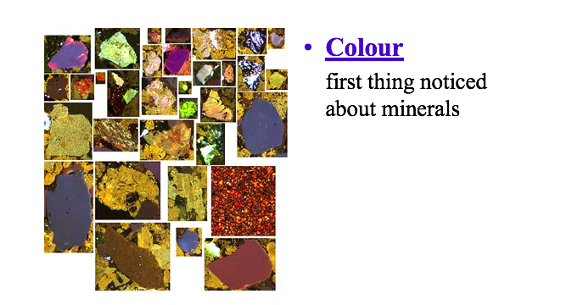
Magnetism
Rock
Texture
Grain
Minerals
Colour
Hardness
Density
Lustre
Streak
Cleavage
Properties of Minerals
Why are we learning to identify minerals?
Identification means we can decide which substance is best suited to a particular task

Slide 21
I know what rocks and minerals are
I know what the three major rock types are
What are the two types of properties?
There are three major groups of rock, classified by the way that they form:
Sedimentary
Metamorphic
Igneous

Slide 22
I know what rocks and minerals are
I know what the three major rock types are
What are the two types of properties?
Sedimentary rocks are formed from the particles of sediments.
Sediments are deposited when rocks are weathered and deposited in another place.
These grains are cemented together to form a rock.
Examples include: sandstone, limestone, siltstone etc.

Slide 23
I know what rocks and minerals are
I know what the three major rock types are
What are the two types of properties?
Metamorphic rocks are rocks that have experienced metamorphism (high temperatures and pressures).
This changes the composition and appearance of the rocks.
Examples include marble, slate and gneiss.

Slide 24
I know what rocks and minerals are
I know what the three major rock types are
What are the two types of properties?
Igneous rocks form from magma (melted rock from the mantle) which has cooled and crystallised.
Examples include: pumice, basalt, granite, obsidian.

Slide 25
I know what rocks and minerals are
I know what the three major rock types are
Why is learning about properties important?
Rocks tell a story – the type of rock tells you what the rock has been through and allows us to draw conclusions about how they formed.

Slide 26
I know what rocks and minerals are
I know the properties of minerals

